Slide 1
UNIT II
TRAVEL AGENCY OPERATIONS
Topic:
Linkages of Travel Agency

Slide 2
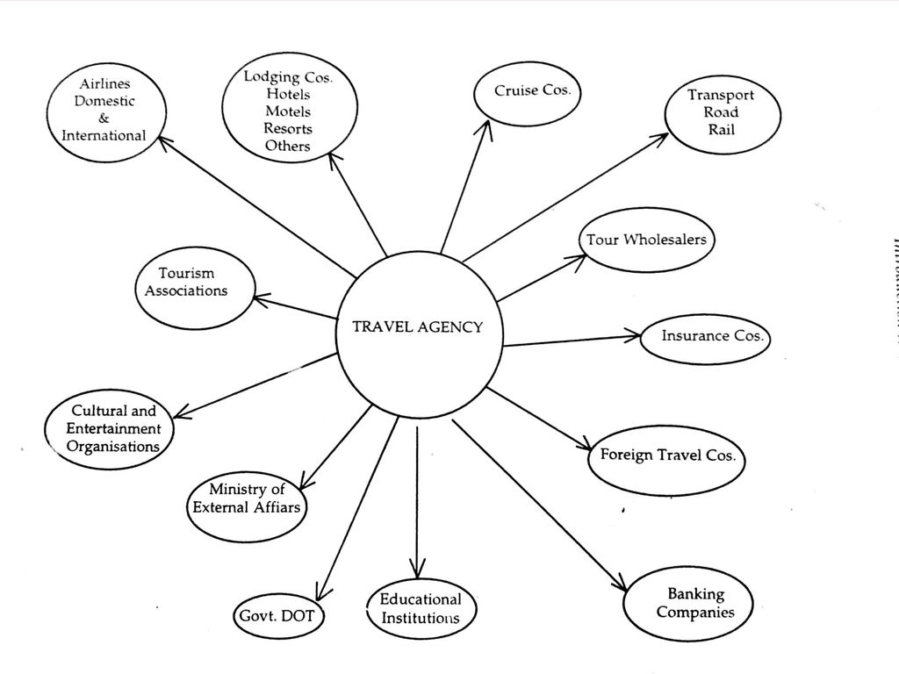

Slide 3
Integration in tourism
Dale (2005) categorizes integration into two types: vertical integration and horizontal integration.
What this means will be clearer if we look at the various elements that form the chain of distribution

Slide 4
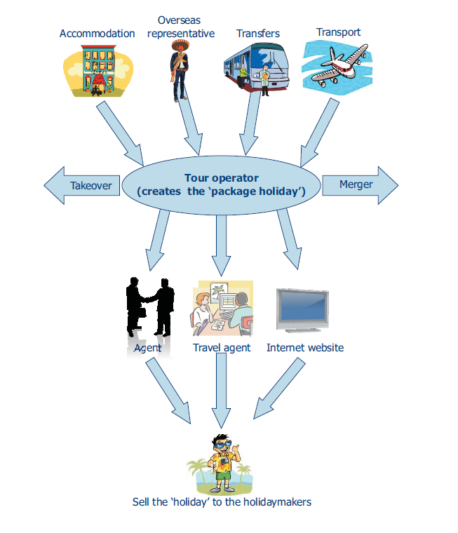

Slide 5
Vertical integration
Vertical integration occurs wherever in the chain of distribution (suppliers, wholesalers, retailers) 'where companies merge or one takes over the other at different levels in the chain of distribution.

Slide 6
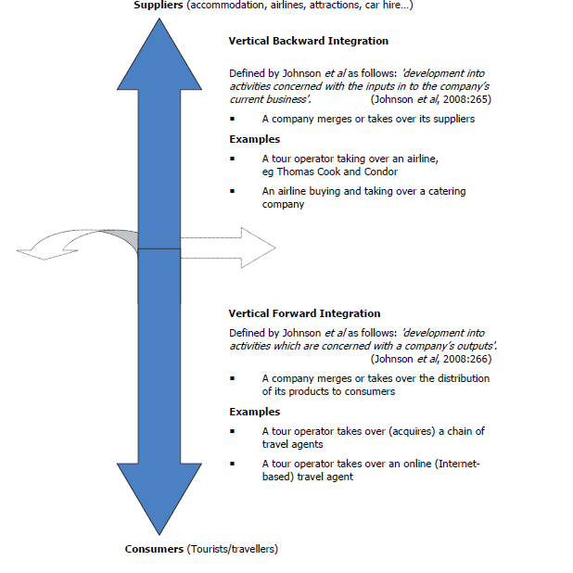

Slide 7
Horizontal integration
Dale defines horizontal integration as: 'where two competing companies offering competing products merge or one takes over the other'.

Slide 8
